Slide 1
Clothes
STUDENT’S BOOK page 31

Slide 2
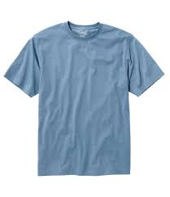
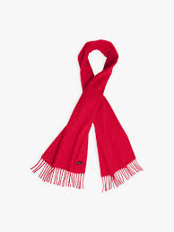
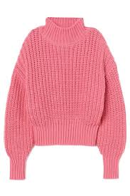
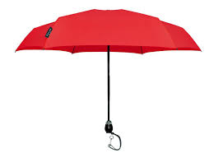
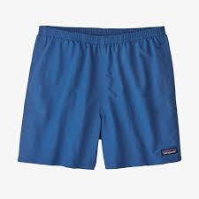
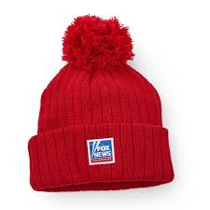
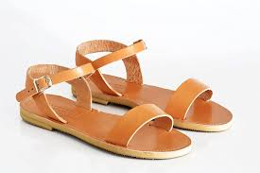
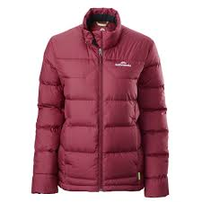
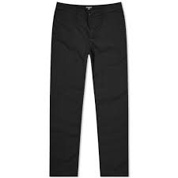
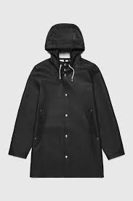
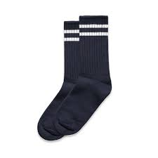
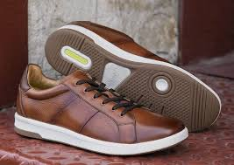
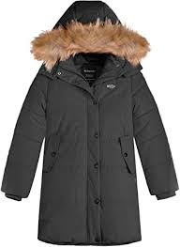
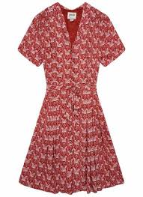
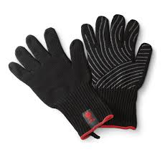
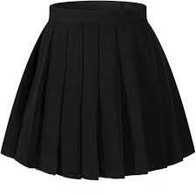
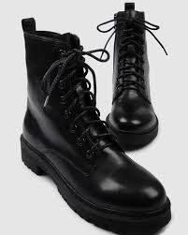
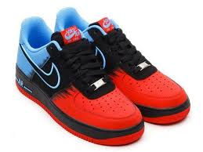

Slide 3
In spring, the weather is windy. People usually wear pants, shirts and jackets. They wear socks and shoes on their feet .
pants a shirt a jacket
socks shoes

Slide 4
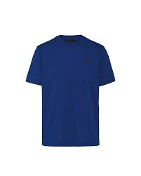
In summer, people wear light clothes. Girls usually wear skirts and dresses.They wear sandals on their feet. Boys usually wear shorts and T-shirts.They wear sneakers on their feet.
a skirt sandals a dress
a T-shirt shorts sneakers

Slide 5
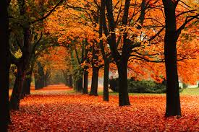
In fall, there is a lot of rain.People usually wear sweaters and raincoats. They wear boots on their feet. They always carry an umbrella.
a raincoat a sweater
boots an umbrella

Slide 6
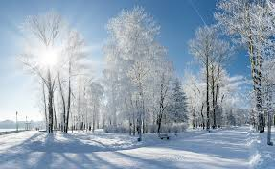
In winter,people wear warm clothes. They usually wear winter coats. They also usually wear a winter hat , a scarf and gloves .
a winter a winter
coat hat
gloves a scarf

Slide 7
HOMEWORK
Activity book, page 35
Ex.1 :Choose the right answers
to the text.

