Slide 1
Engleski jezik
4. razred

Slide 2
HELLO!

Slide 3
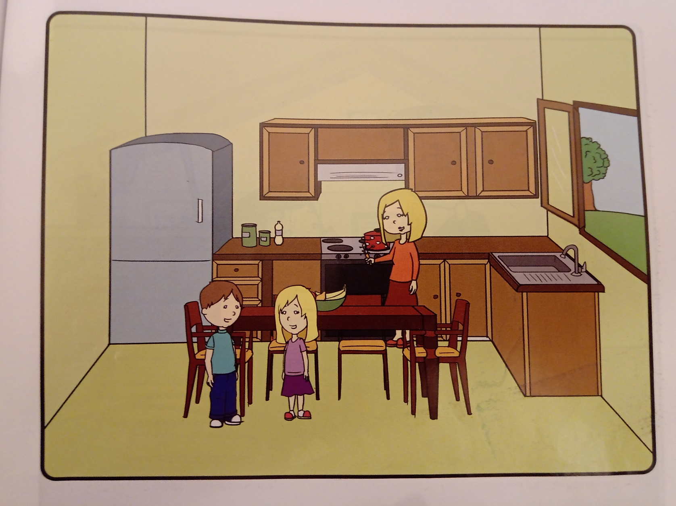
IN THE KITCHEN
page 33

Slide 4
Mrs. Kecman is making dinner. Milica and Marko are in the kitchen.
Milica: Mom, it’s my birthday tomorrow, I want to make the cake. Can I make it now, before dinner?
Mrs. Kecman: No, make it after dinner, and wash the dishes. You can wash the dishes, and your brother can dry the dishes. Marko, close the window and open the cupboard. Take four plates, four glasses and four cups. Let’s set the table.

Slide 5
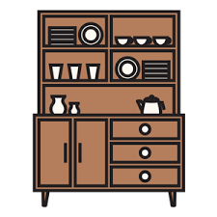
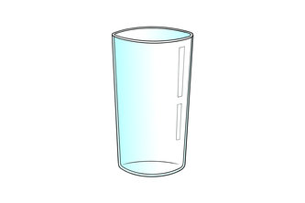
New words
cupboard – ormarić
dishes – suđe
wash – prati
dry – sušiti
glass – čaša
cup – šolja
set – postaviti
now – sada
before/after – prije/poslije

Slide 6
before
after
now
Sunday
Tuesday
Monday

Slide 7
Zadaća: radna sveska,
prvi zadatak na strani 35

Slide 8
GOODBYE!

